Slide 1

Project Review - 2
Course Code - 24DEA3101
Faculty : Dr. N. Shirisha
Associate Professor
Real-Time Banking Transaction Analytics & Anomaly Monitoring Platform
FDE TEAM 21
B Raghu Nandan - 2420030058
C Pravin Sai - 2420030777
J Hemanth - 2420039805

Slide 2
Project Abstract
This project focuses on building a scalable and fault-tolerant Real-Time Banking Transaction Analytics Pipeline that can ingest, process, and analyze live banking transaction data.
The system follows a Medallion Architecture, using Apache Kafka for continuous transaction ingestion and PySpark Structured Streaming for real-time data processing, validation, transformation, and anomaly monitoring.
To maintain data quality and prevent processing failures, the pipeline includes a Quarantine Layer that automatically separates malformed or invalid transactions. It also monitors unusual transaction patterns such as sudden increases in transaction frequency or value to help identify potential anomalous activity at an early stage.
The processed data moves through the Bronze and Silver layers before being stored in Delta Lake, which provides reliable and ACID-compliant data storage. Apache Airflow then manages the transformation of cleaned data into a Star Schema in the SQLite Gold layer.
Finally, the processed data is presented through interactive Power BI dashboards, providing important business insights such as transaction volume, transaction value, failed transactions, anomaly indicators, and transaction trends. This helps financial organizations understand transaction behavior and make faster, data-driven decisions.

Slide 3
Introduction
Digital banking platforms generate a continuous stream of transaction data through activities such as online payments, money transfers, ATM withdrawals, deposits, and bill payments. Processing this data in real time is important for monitoring transaction behavior, improving business decisions, and identifying unusual activity.
This project develops a Real-Time Banking Transaction Analytics Pipeline that captures and processes live transaction data using Apache Kafka and PySpark Structured Streaming. The system follows a Medallion Architecture to organize and progressively improve the quality of data.
The pipeline also includes fault-tolerant data handling, anomaly monitoring, and automated workflow management using Apache Airflow. The processed data is stored in Delta Lake and SQLite, and the final insights are presented through Power BI dashboards.
The overall goal is to transform raw, real-time banking transactions into reliable and actionable business intelligence.

Slide 4
Tech Stack
Data Generation & Ingestion
Python: Generates continuous banking transaction events such as transfers, online payments, ATM withdrawals, deposits, and bill payments.
Apache Kafka: Handles high-volume real-time transaction streaming and reliably transfers data to the processing layer.
Data Processing & Storage
PySpark Structured Streaming: Processes Kafka streams, validates transactions, handles invalid records, performs transformations, and monitors transaction patterns.
Delta Lake: Provides scalable and ACID-compliant storage for the Bronze and Silver layers.
SQLite: Stores the refined Gold layer data for efficient querying and analysis.
Orchestration & Visualization
Apache Airflow: Automates and manages workflows for transforming Silver layer data into Gold layer business metrics.
Power BI: Creates interactive dashboards for visualizing transaction volume, transaction value, failed transactions, anomalies, and trends.
Architecture
Python → Apache Kafka → PySpark → Delta Lake → Apache Airflow → SQLite → Power BI

Slide 5
Objectives
Successfully build a real-time banking transaction analytics pipeline.
Continuously ingest and process banking transactions using Kafka and PySpark.
Validate transaction data and isolate invalid records using the Quarantine Layer.
Store and progressively improve data through Bronze and Silver layers using Delta Lake.
Detect and monitor unusual transaction patterns using configurable rules and statistical features.
Automate downstream data processing using Apache Airflow.
Develop Power BI dashboards showing transaction volume, transaction value, failed transactions, anomalies and trends.
Evaluate the pipeline based on throughput, latency, data quality and failure recovery.

Slide 6
Literature Survey
Paper Title | Reference Link | Drawbacks | Future Work
Near Real-Time Anomaly Detection in Customer Transactions Using Lambda Architecture | IJIRCT | Lambda Architecture requires separate batch, speed, and serving layers, which can increase operational complexity. | Explore a simpler unified streaming and layered architecture such as the Medallion approach used in BankFlow Analytics.
Real Time Fraud Detection Using Machine Learning | IJIRT | The work discusses ML and streaming, but does not cover a complete data pipeline with validation, storage, and business reporting. | Connect ML or anomaly scoring with a complete streaming pipeline for processing and analysis.
Real-Time Financial Data Processing Using Apache Spark and Kafka | IJDSML | It focuses mainly on Kafka and Spark based financial processing and gives limited attention to invalid-record handling. | Add validation and a Quarantine Layer so malformed transaction records do not interrupt processing.
Real-Time Fraud Detection with Kafka Streams and Spring Boot | Medium | The implementation uses Kafka Streams and Spring Boot rather than a distributed Spark processing pipeline. | Extend the approach using PySpark Structured Streaming for larger-scale transformations and window-based analysis.
Real-Time Data Streaming to Detect Financial Fraud Using Condense | Zeliot | The approach depends on a managed commercial streaming platform and is more production-oriented than the academic project. | Implement similar streaming ideas using open-source technologies such as Kafka, PySpark, and Delta Lake.

Slide 7
Literature Survey
Real-Time Fraud Detection Using Kafka and Machine Learning | DEV Community | The proof of concept uses a simple model and a limited set of transaction features. | Add event-time windows, configurable anomaly rules, and richer transaction features.
Anomaly Detection: A Survey | ACM / Paper | The study provides a broad overview of anomaly detection but is not specifically focused on streaming banking transactions. | Select lightweight and explainable anomaly detection methods suitable for continuous transaction streams.
SCARFF: A Scalable Framework for Streaming Credit Card Fraud Detection with Spark | ScienceDirect | SCARFF provides a more complex fraud detection framework than required for a project-scale academic implementation. | Apply its streaming and feature-engineering ideas while keeping BankFlow's anomaly monitoring simple and explainable.
Credit Card Fraud Detection: A Realistic Modeling and a Novel Learning Strategy | IEEE / DOI | The study focuses on supervised fraud detection, concept drift, and class imbalance, which require labelled historical data. | Evaluate adaptive anomaly detection models when labelled transaction data becomes available.
Sequence Classification for Credit-Card Fraud Detection | ScienceDirect | Sequence-based methods require transaction history and more complex feature preparation than the current rule-based approach. | Extend BankFlow with temporal or sequence-based models after the core streaming pipeline is stable.

Slide 8
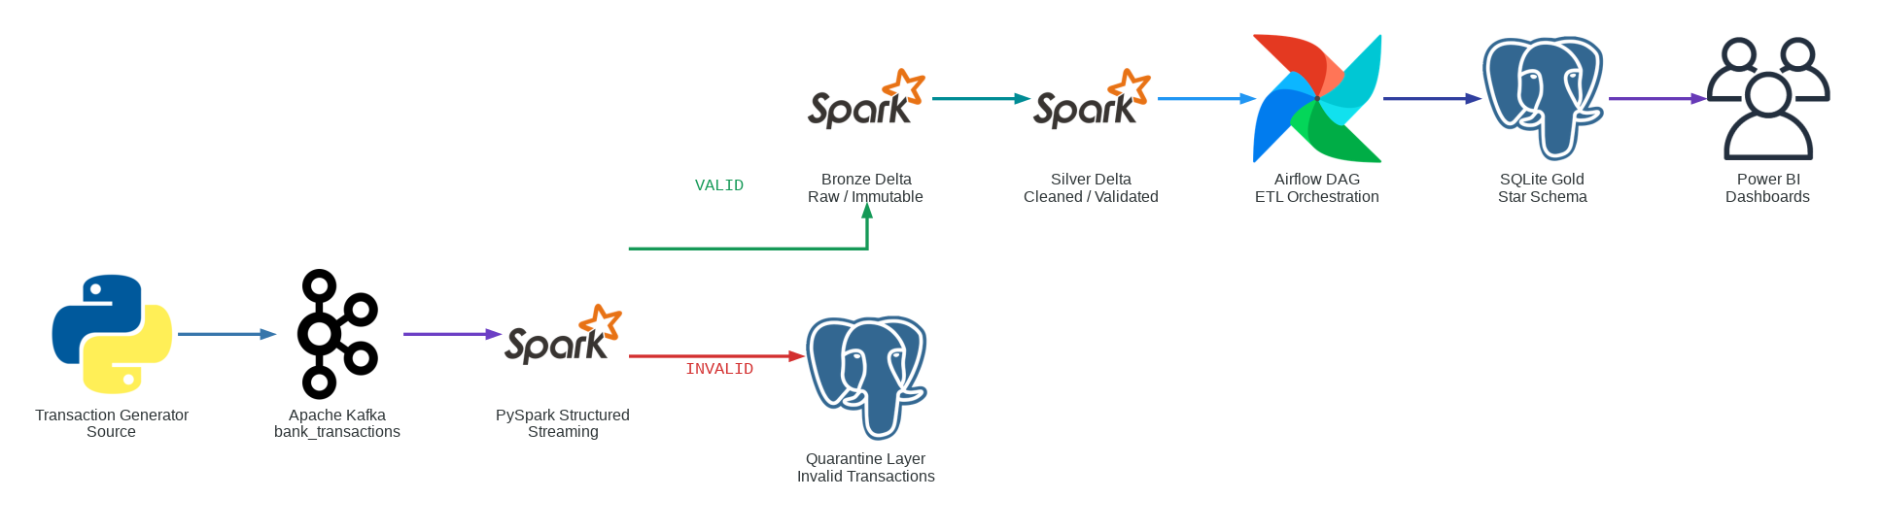
System Architecture

Slide 9
THANK YOU

